Slide 1
String theoretic QCD axions
in the light of PLANCK and BICEP2
Kiwoon Choi
@ CosKASI Conference, April 16, 2014
KC, K.S. Jeong and M.S. Seo, arXiv:1404.3880
The IBS Center for Theoretical Physics of the Universe

Slide 2
Outline
* Introduction
* String theoretic axions
* Cosmological constraints on the QCD axion
* Implications for the string theoretic QCD axions

Slide 3
Strong CP problem
CP violating couplings in the Standard Model of particle physics:
➔ Neutron EDM:
➔
Why |θ_{QCD}+ Arg Det(y_{q})| < 10⁻¹⁰, while δ_{KM} ~ Arg (y_{q}) ~ 1 ?
(Unlike the gauge hierarchy problem, anthrophic argument can not
explain this puzzle!)

Slide 4
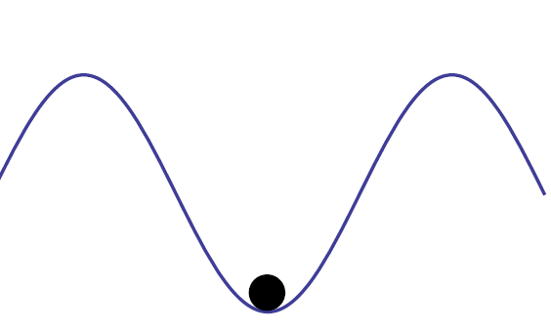
Axion solution to the strong CP problem
Introduce a spontaneously broken anomalous global U(1) symmetry
(Peccei-Quinn symmetry), which makes θ_{QCD} a dynamical field “axion”
= Goldstone boson of the spontaneously broken U(1)_{PQ}
( f_{a} = Axion scale = Scale of the spontaneous breaking of U(1)_{PQ} )
➔ Low energy QCD dynamics develops an axion potential minimized
at <a > = 0:
a/f_{a}
Dynamical relaxation of θ_{QCD}+ Arg Det(y_{q}) = $<$a $>$ / f_{a}

Slide 5
Most of the physical properties of axion is determined by f_{a}:
axion mass:
axion-photon coupling:
Questions about the QCD axion:
* What is the origin of the global U(1)_{PQ} which is explicitly broken
dominantly by the QCD anomaly ?
U(1)_{PQ} should be protected well from quantum gravity effects
which generically do not respect global symmetries:
We need an explanation for the huge suppression of the explicit breakdown
of the PQ symmetry by quantum gravity effects.

Slide 6
* What is the mechanism to generate the axion scale in a way
consistent with the severe astrophysical and cosmological
constraints ?
Star cooling:
Relic axion abundance, Axion isocurvature perturbations, …
➔ (before BICEP2)
Upper bound on the axion scale depends on a variety of cosmological factors
such as
- Axion misalignment and quantum fluctuations during inflation
(if the PQ symmetry were spontaneously broken during inflation)
- Dynamics of the axionic string-wall system
(if the PQ symmetry were restored during inflation)

Slide 7
String theoretic QCD axions
String theory seems to be the right place to ask the origin of the PQ symmetry
as it is supposed to be a viable theory of quantum gravity.
Indeed 4D effective theory of string compactification generically involves
axion-like fields originating from higher-dim antisymmetric tensor gauge fields.
Witten ‘84
Gauge-axion unification in string theory
➔ 4-dim global PQ symmetry which is locally equivalent to
a higher-dim gauge symmetry
This may explain why the explicit breakings of the PQ symmetry by
quantum gravity effects are so suppressed.

Slide 8
Example:
Antisymmetric tensor gauge field on 2-sphere S₂ with radius R
in the internal space, with a gauge symmetry:
Harmonic area 2-form on S₂ :
➔
Axion-like fluctuation:
Global shift symmetry locally equivalent to the gauge symmetry :
➔

Slide 9
This means that U(1)_{shift} : a_{st} → a_{st} + constant can be broken only by
non-perturbative effects that are associated with
* Stringy instantons wrapping S₂ :
* Axion couplings to the 4-dim gauge field instantons
It is then quite conceivable that this shift symmetry is broken dominantly
by the axion coupling to the QCD instantons, and the huge suppression
of other explicit symmetry breakings at UV scales is explained by that
U(1)_{PQ} = U(1)_{shift} is locally equivalent to a higher-dim gauge symmetry.

Slide 10
As we will see, this simple scheme of gauge-axion unification now appears to
be excluded by the PLANCK constraints on isocurvature density perturbations
and the recent detection of tensor modes in the CMB by BICEP2.
PQ symmetry is non-linearly realized at the string scale (there is no phase
of restored PQ symmetry), which results in the axion scale around the GUT
scale: KC & Kim ‘85
This simple estimate of the axion scale turns out to be right for the most
of compactified string models in which the compactification scale is close
to the reduced Planck scale M_{Planck} = 2.4 x 10¹⁸ GeV. Svrcek & Witten ‘06
(cf: BICEP2 → → )

Slide 11
Generalization with anomalous U(1)_{A} gauge symmetry:
In fact, string theory allows an even more interesting and still viable
generalization of this gauge-axion unification scheme, in which U(1)_{PQ} is
still locally equivalent to a gauge symmetry, while the axion scale can be
well below the GUT scale.
* Global shift symmetry which is locally equivalent to higher-dim gauge
symmetry:
* Anomalous U(1) gauge symmetry with vanishing Fayet-Illiopoulos term,
under which the QCD axion is charged:
U(1)_{PQ} = Combination of U(1)_{shift} and U(1)_{A}
QCD axion = Combination of a_{st} and arg(ф)

Slide 12
String theoretic QCD axion with anomalous U(1)_{A} gauge symmetry:
Mass parameters: Stuckelberg mass:
Fayet-Illiopoulos (FI) term:
Matter field VEV:
QCD axion scale:
If , so that , the axion scale can be far below the GUT scale:
which can be realized in many string models including the Type II string theory
with D-branes and the heterotc string theory with U(1) gauge bundles.
(This scheme allows a restored PQ symmetry with v = 0.)

Slide 13
Cosmological constraints on the QCD axions
* Case that the PQ symmetry is spontaneoulsy broken
(non-linearly realized) during and after inflation:
No axionic strings or domain walls, but the axion field could have
a classical misalignment and de-Sitter quantum fluctuations:
PLANCK constraint on isocurvature perturbation:
BICEP2 detection of tensor modes in the CMB:
→

Slide 14
Axion dark matter produced by the coherent oscillation of misaligned axion field:
Axion isocurvature power spectrum:
(Non-Gaussianity )
For , it turns out that the main constraint comes from

Slide 15
* Case that the PQ symmetry is restored during inflation or reheating:
To avoid the domain wall problem, we first need
Axion domain-wall number =
Axion dark matters are produced by the collapsing axionic string & domain wall
system, as well as by the coherent oscillation of misaligned axion field:
➔

Slide 16
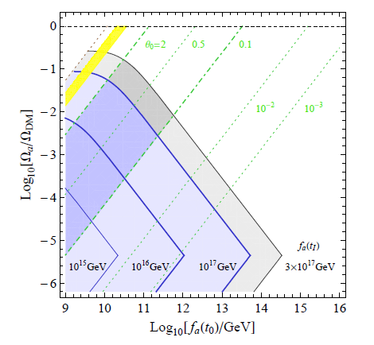
KC, Jeong, Seo
The PQ symmetry should be either restored, or broken at much
higher scale during inflation: f_{a}(t_{Inf}) = 0 or f_{a}(t_{Inf}) $≫$ f_{a}(t₀)

Slide 17
Implications for string theoretic QCD axion
* String theoretic QCD axion which originates from antisymmetric tensor
gauge fields with is now excluded.

Slide 18
* Cosmological constraints from PLANCK and BICEP2 require that the PQ
symmetry is either restored ( ), or broken at a much higher scale
( ), during inflation.
This provides an important hint about the physics generating the axion scale,
suggesting that the axion scale is generated by SUSY-breaking effects,
which can be successfully implemented in string theoretic axion models
with anomalous U(1) gauge symmetry:
Present universe:
➔
Inflation epoch:
➔

Slide 19
More careful analysis shows that the Hubble-induced D-term of U(1)_{A}
plays an important role for the PQ breaking during inflation.
For generic parameter region,
so the PQ symmetry is spontaneously broken with
although there exists an unnatural range of parameters, for which
the PQ symmetry is restored during inflation.

Slide 20
Most plausible range of f_{a}(t₀) and Ω_{a} in view of our results:

Slide 21
Conclusion
* Compactified string models involving an anomalous U(1) gauge symmetry
appears to be the best theoretical setup for the QCD axion:
Explains the origin of the PQ symmetry well protected from quantum gravity,
while giving an axion scale well below the GUT scale.
* PLANCK and BICEP2 results require that either the PQ symmetry is restored,
or broken at much higher scale, during the inflation epoch.
Suggests that the PQ symmetry is spontaneously broken due to SUSY-breaking
effects, leading to an interesting connection between the axion scale and
the SUSY breaking scalar mass:

Slide 22
* More careful analysis of the dynamics of the model implies that the PQ
symmetry is spontaneously broken during inflation for generic model
parameters, and the QCD axions might be here.
➔ Axion scale SUSY (n=0):
or Low scale SUSY (n=1):

