Slide 1
Sampling Artifact in Volume Weighted Velocity Measurement and Halo Velocity Bias
Yi Zheng 郑逸
Supervisor: Pengjie Zhang
Y. Zheng, P. Zhang, Y. Jing, W. Lin, and J. Pan, Phys. Rev. D 88, 103510 (2013), 1308.0886
P. Zhang, Y. Zheng, Y. Jing, (2014, paperSI), in preparation
Y. Zheng, P. Zhang, Y. Jing, (2014, paperSII), in preparation
Y. Zheng, P. Zhang, Y. Jing, (2014, paperB), in preparation

Slide 2
Outline
We want to measure halo velocity bias, volume-weighted. (Y. Zheng, P. Zhang, Y. Jing, (2014, paperB), in preparation)
We find non-negligible systematic error in volume-weighted velocity measurement! (1308.0886; Y. Zheng, P. Zhang, Y. Jing, (2014, paperB), in preparation)
We try to understand this systematic error theoretically and by simulation. (P. Zhang, Y. Zheng, Y. Jing, (2014, paperSI), in preparation; Y. Zheng, P. Zhang, Y. Jing, (2014, paperSII), in preparation)
Now we have achieved several percent level accuracy, but not enough, O(1%)! (paperSII)

Slide 3
Motivation: Why halo velocity bias matters?
In linear theory:
Desjacques & Sheth 0909.4544
Weak equivalence principle
Environmentally dependent evolution
halos
galaxies
Lagrangian velocity bias: non-negligible!
Desjacques 0806.0007,
Desjacques & Sheth 0909.4544
Relation between Lagrangian and Eularian space: complicated!
?
e.g. Colberg et al. MNRAS 313, 229
Eularian velocity bias:
Notes:
So far we have been talking about dark matter RSD. But what we really concern is the galaxy RSD. From DM to GAL, there are 2 biases to deal with. 1st … the widely discussed density bias, 2nd the velocity bias relative to the DM vel field. Though the weak equivalence principle guarantees that LSS tracers sense the same acceleration as ambient dark matter particles. However, LSS tracers in general do not have the same spatial clustering as dark matter particles. For example, galaxies only
reside around local density peaks. This environmental difference in principle induces velocity bias in LSS tracers. As the first step….GAL vel bias, halo vel bias.

Slide 4
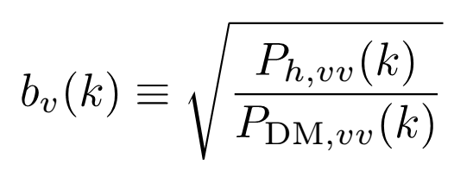
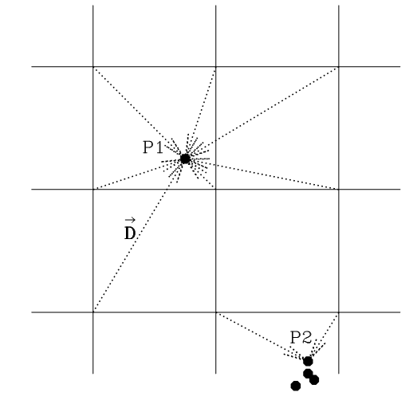
How to measure the halo velocity bias?
Power spectrum of volume weighted
velocity of dark matter halos
Power spectrum of volume weighted
velocity of dark matter particles
Nearest Particle (NP) method:
‘volume-weighted’:
For a given grid point, we assign the velocity of its nearest dark matter particle/halo/galaxy to it.
Simulation speculation:
Notes:
Procedure straightforward . Keypoint, systematic error. NP method related sys err induced by 3 aspects: 1 grid number 2 number density 3 clustering property of tracers. In principle, we need to compare the halo and DM sample with the same situation to minimiaze the sye error. So for 1 we… for 2 we … for 3 complicated, the 2 different in nature but we could some tests to verify for k<0.1 if this is important.

Slide 5
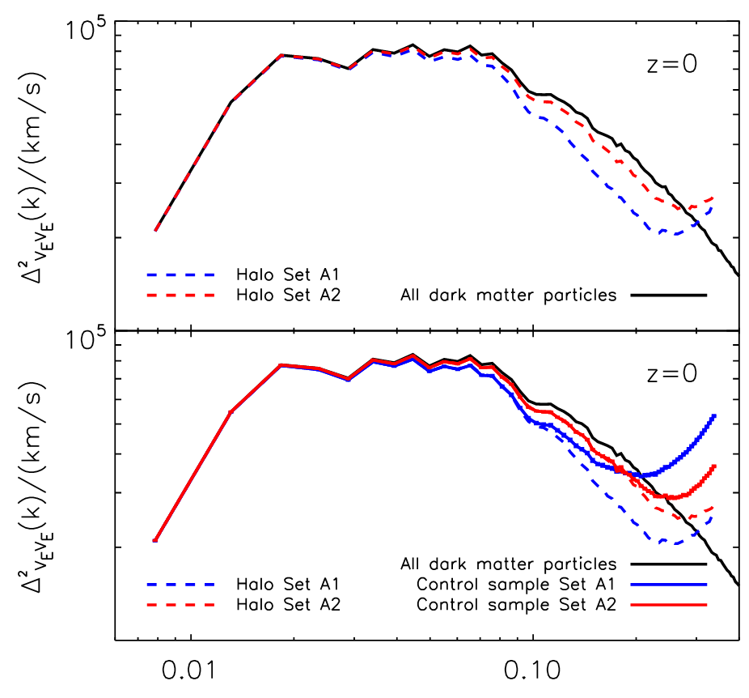
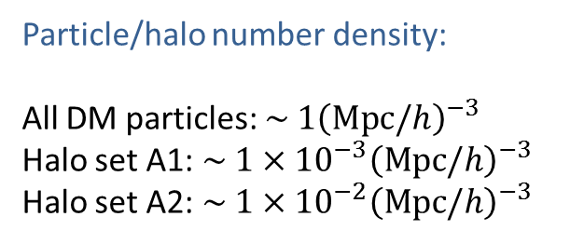
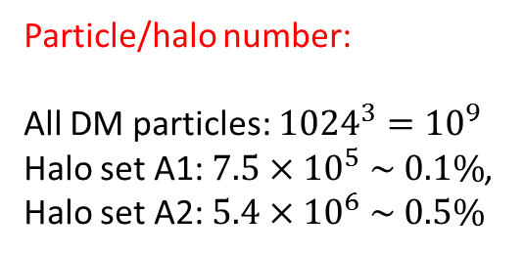
An example of sys. Err.:
preliminary
Particle/halo number:
All DM particles: ${1024}^{3}={10}^{9}$
Halo set A1: $7.5×{10}^{5} \sim 0.1\%$,
Halo set A2: $5.4×{10}^{6} \sim 0.5\%$
512^3 grids
128^3 grids
Particle/halo number density:
All DM particles: $\sim 1{\left(Mpc/h\right)}^{−3}$
Halo set A1:$\sim 1{×{10}^{−3}\left(Mpc/h\right)}^{−3}$
Halo set A2:$\sim 1{×{10}^{−2}\left(Mpc/h\right)}^{−3}$
Non-neglectable >10% systematic errors!
YZ et al. paperB, in preparation

Slide 6
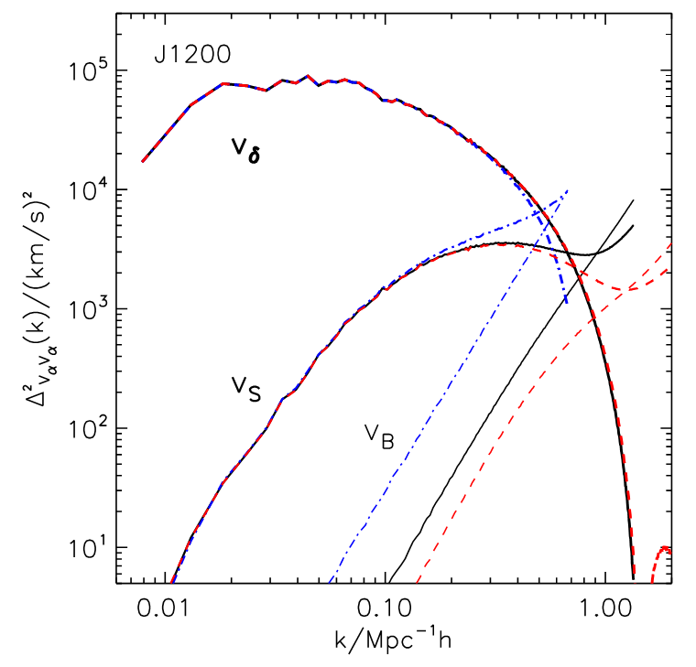
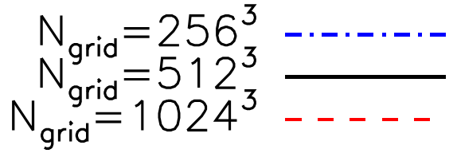
More clues: 1. grid size induced sys. Err.
Use all DM particles: ${1024}^{3}\sim {10}^{9}$
$$v_{δ}+v_{S}=v_{E}$$
Velocity decomposition,
see PJZ et al. 1207.2722
Fair comparison demands the same grid numbers for dark matter particles and halos.
1308.0886
Notes:
When we study the properties of dark matter particles, we have found some clues, thought there err could be safely nelegted,we found tha…

Slide 7
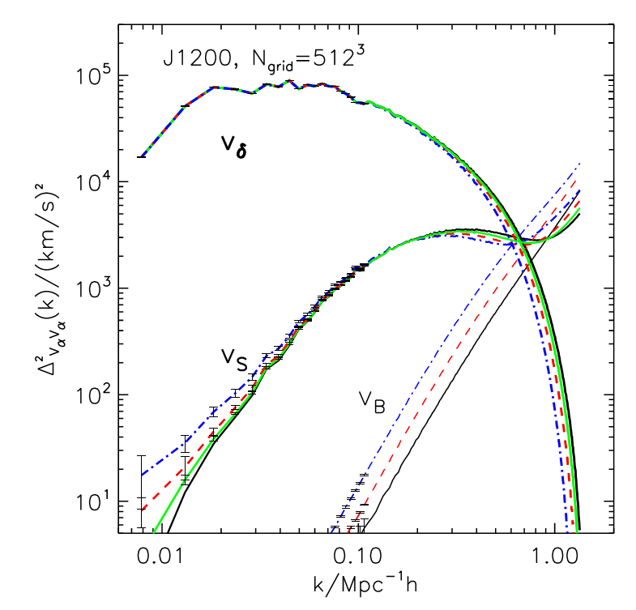
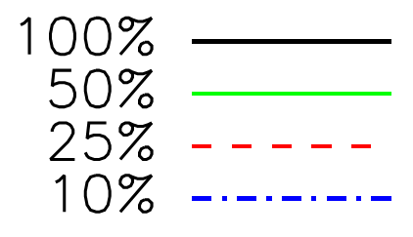
More clues: 2. number density induced sys. Err.
100%: $\sim 1{\left(Mpc/h\right)}^{−3}$
10%: $\sim 0.1{\left(Mpc/h\right)}^{−3}$
$$v_{δ}+v_{S}=v_{E}$$
Velocity decomposition,
see PJZ et al. 1207.2722
Fair comparison demands the same number density for dark matter particles and halos or we quantify and correct the numerical artifacts.
1308.0886
Notes:
Though could be neglected, halo, fixed number density.,…..

Slide 8
Systematic errors of NP method: theory
The estimated velocity on the grid position $x$ is assigned as that of the nearest particle at $x_{P}(x)$:
Similar to CMB lensing (U.Seljak, 1996), we can treat this new velocity field as the original one “lensed” from $x$ to $x_{P}\left(x\right).$ We could define a defection field:
For dark matter velocity field, we could work in the limit of
But for halos, the number density is low and fixed.
So we have to work in the case of
This distinguishes our work from existing ones.
PJZ et al. paperSI, in preparation

Slide 9
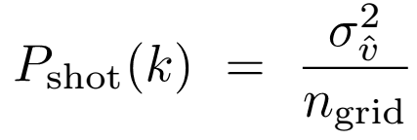
Systematic errors of NP method: theory
1. Shot noise correction:
2. Sampling effect correction (first order):
Directly measurable!
Directly measurable!
Assumptions: 1. $D$field uncorrelated with the velocity field
2. $D$ field uncorrelated with itself
More details see PJZ et al. paperSI, in preparation

Slide 10
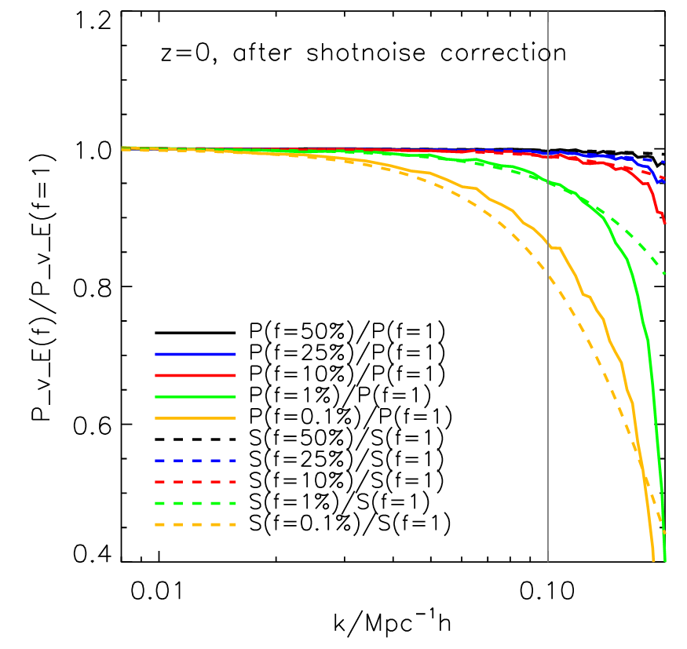
Systematic errors of NP method: simulation
2. Sampling effect correction (first order):
preliminary
Already several percent accuracy!
Halo set A1

Slide 11
Discussion
Other velocity assignment methods suffer from this systematic error too.
We need higher order correction to archive O(1%) systematic errors ?

